Slide 1
DES -- Example
This lecture slide is mainly based on the power point slides by Professor Lawrie Brown.
Notes:
Zili Shao

Slide 2
DES Key Generater
Generating subkeys used in each round
Consisting of:
  Initial permutation of the key (PC1) which selects 56-bits in two 28-bit halves
  16 stages consisting of:
    selecting 24-bits from each half
    permuting them by PC2 for use in function F,
    rotating each half separately either 1 or 2 places depending on the key rotation schedule K
CEG 260, Meilin Liu
Notes:
Zili Shao
The 56 bit key size comes from security considerations as we know now. It was big enough so that an exhaustive key search was about as hard as the best direct attack (a form of differential cryptanalysis called a T-attack, known by the IBM & NSA researchers), but no bigger. The extra 8 bits were then used as parity (error detecting) bits, which makes sense given the original design use for hardware communications links. However we hit an incompatibility with simple s/w implementations since the top bit in each byte is 0 (since ASCII only uses 7 bits), but the DES key schedule throws away the bottom bit! A good implementation needs to be cleverer!
Details of these permutations and the key rotation schedule are given in text Table 3.4.

Slide 3
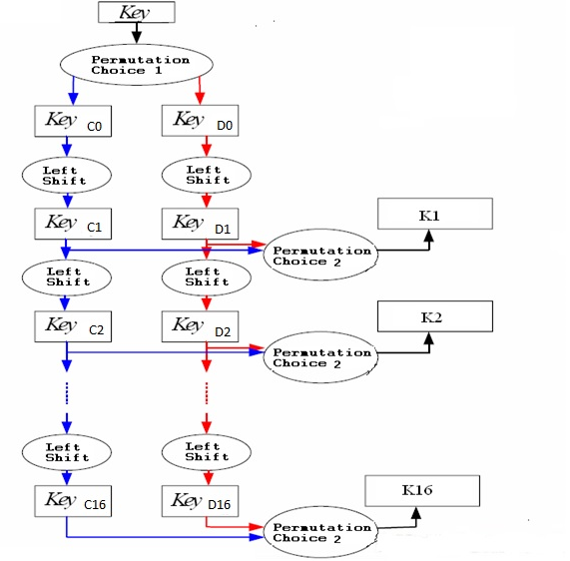
Key Generator
CEG 260, Meilin Liu
Notes:
Zili Shao

Slide 4
Input Key
1 2 3 4 5 6 7 8
9 10 11 12 13 14 15 16
17 18 19 20 21 22 23 24
25 26 27 28 29 30 31 32
33 34 35 36 37 38 39 40
41 42 43 44 45 46 47 48
49 50 51 52 53 54 55 56
57 58 59 60 61 62 63 64
CEG 260, Meilin Liu
Notes:
Zili Shao

Slide 5
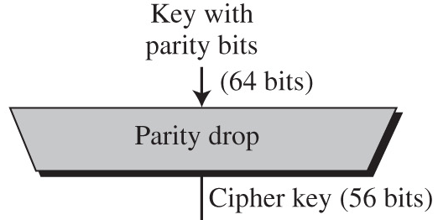
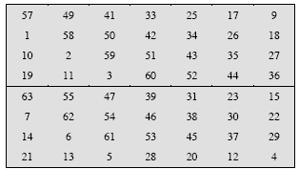
Parity Bit Drop, Permutation Choice 1
Every 8th bit of key input used for parity check to detect transmission errors
This stage removes the parity bits and shuffles key bits
Permutation Choice 1
CEG 260, Meilin Liu
Notes:
Zili Shao

Slide 6
Key Generator
Round Number | 1 | 2 | 3 | 4 | 5 | 6 | 7 | 8 | 9 | 10 | 11 | 12 | 13 | 14 | 15 | 16
Number of Left Shifts | 1 | 1 | 2 | 2 | 2 | 2 | 2 | 2 | 1 | 2 | 2 | 2 | 2 | 2 | 2 | 1
Total Number of Shifts | 1 | 2 | 4 | 6 | 8 | 10 | 12 | 14 | 15 | 17 | 19 | 21 | 23 | 25 | 27 | 28
rounds 1, 2, 9, 16: single-bit rotate left
otherwise: two-bit rotate left
CEG 260, Meilin Liu
Notes:
Zili Shao

Slide 7
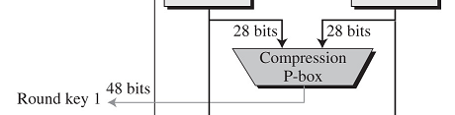
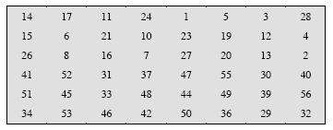
Round Key Compression, Permutation Choice 2
Reduces round key to 48 bits to match bits in mixer
Combined with shifts, assures different bits used in each round key (different bits removed each round)
Bits 9,18,22,25,35,38,43,54 are dropped.
CEG 260, Meilin Liu
Notes:
Zili Shao

Slide 8
DES Example - Key
K = 581FBC94D3A452EA
X = 3570E2F1BA4682C7
K = ( 0101 1000 0001 1111 1011 1100 1001 0100
1101 0011 1010 0100 0101 0010 1110 1010 )
Permutated Choice One (PC-1)
C₀ = ( 1011110 0110100
0110100 1000101 )
D₀ = ( 1101001 0001011
1010000 1111111 )
CEG 260, Meilin Liu
Notes:
Zili Shao

Slide 9
DES Example - Key
C₁ = ( 0111 1001 1010 0011 0100 1000 1011 )
D₁ = ( 1010 0100 0101 1101 0000 1111 1111 )
K₁ = ( 001001 111010 000101 101001
111001 011000 110111 011010 )
C₂ = ( 1111 0011 0100 0110 1001 0001 0110 )
D₂ = ( 0100 1000 1011 1010 0001 1111 1111 )
K₂ = ( 110110 101001 000111 011101
110101 111011 011101 001000 )
CEG 260, Meilin Liu
Notes:
Zili Shao

Slide 10
DES Initial Permutations
58 50 42 34 26 18 10 2
60 52 44 36 28 20 12 4
62 54 46 38 30 22 14 6
64 56 48 40 32 24 16 8
57 49 41 33 25 17 9 1
59 51 43 35 27 19 11 3
61 53 45 37 29 21 13 5
63 55 47 39 31 23 15 7
CEG 260, Meilin Liu
Notes:
Zili Shao

Slide 11
DES Example - Data
K=581FBC94D3A452EA
X=3570E2F1BA4682C7
X = (x₁, x₂, x₃, …, x₆₄)
= ( 0011 0101 0111 0000 1110 0010 1111 0001
1011 1010 0100 0110 1000 0010 1100 0111)
This plaintext X is first subjected to an Initial Permutation – IP which gives
L₀ = ( 1010 1110 0001 1011 1010 0001 1000 1001)
A E 1 B A 1 8 9
R₀ = ( 1101 1100 0001 1111 0001 0000 1111 0100)
D C 1 F 1 0 F 4
CEG 260, Meilin Liu
Notes:
Zili Shao

Slide 12
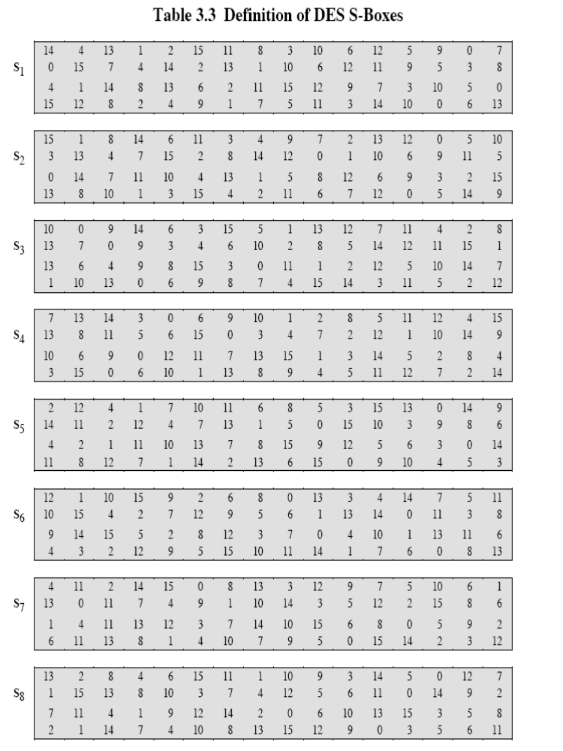
The 8 DES S Boxes
CEG 260, Meilin Liu
Notes:
Zili Shao

Slide 13
DES Example - Data
E(R₀) = ( 011011 111000 000011 111110
100010 100001 011100 101001)
Γ₁ = E(R₀) ⊕ K₁
= ( 010010 000010 000110 010111
011011 111001 101001 110011)
S₅⁰¹(1101) = S₅¹(13) = 9 = 1001
S₆¹¹(1100) = S₆³(12) = 6 = 0110
S₇¹¹(0100) = S₇³(4) = 1 = 0001
S₈¹¹(1001) = S₈³(9) = 12 = 1100
CEG 260, Meilin Liu
Notes:
Zili Shao

Slide 14
DES Example - Data
B₁ = (1010 0001 1110 1100 1001 0110 0001 1100)
P(B₁) = (0010 1011 1010 0001 0101 0011 0110 1100)
R₁ = P(B₁) ⊕ L₀
= (1000 0101 1011 1010 1111 0010 1110 0101)
8 5 B A F 2 E 5
CEG 260, Meilin Liu
Notes:
Zili Shao

Slide 15
DES Example - Data
L₁ = (1101 1100 0001 1111 0001 0000 1111 0100)
D C 1 F 1 0 F 4
E(R₁) = ( 110000 001011 110111 110101
011110 100101 011100 001011)
Γ₂ = E(R₁) ⊕ K₂
= ( 000110 100010 110000 101000
101011 011110 000001 000011)
CEG 260, Meilin Liu
Notes:
Zili Shao

Slide 16
DES Example - Data
S₁⁰⁰(0011) = S₁⁰(3) = 1 = 0001
S₂¹⁰(0001) = S₂²(1) = 14 = 1110
S₃¹⁰(1000) = S₃²(8) = 11 = 1011
S₄¹⁰(0100) = S₄²(4) = 12 = 1100
S₅¹¹(0101) = S₅³(5) = 14 = 1110
S₆⁰⁰(1111) = S₆⁰(15) = 11 = 1011
S₇⁰¹(0000) = S₇¹(0) = 13 = 1101
S₈⁰¹(0001) = S₈¹(1) = 15 = 1111
CEG 260, Meilin Liu
Notes:
Zili Shao

Slide 17
DES Example - Data
B₂ = (0001 1110 1011 1100 1110 1011 1101 1111)
P(B₂) = (0101 1111 0011 1110 0011 1001 1111 0111)
R₂ = P(B₂) ⊕ L₁
= (1000 0011 0010 0001 0010 1001 0000 0011)
8 3 2 1 2 9 0 3
L₂ = R₁ = (1000 0101 1011 1010 1111 0010 1110 0101)
8 5 B A F 2 E 5
CEG 260, Meilin Liu
Notes:
Zili Shao

Slide 18
DES Example - Data - Done !
Y = (y₁, y₂,y₃, …, y₆₄)
= ( 1101 0111 0110 1001 1000 0010 0010 0100
0010 1000 0011 1110 0000 1010 1110 1010)
= ( D 7 6 9 8 2 2 4 2 8 3 E 0 A E A)
CEG 260, Meilin Liu
Notes:
Zili Shao

